Slide 1
Cross-Platform Mobile Application Development with Xamarin
Module 3, Lesson 10:
Developing Universal Windows Platform (UWP) Apps with Xamarin
Notes:
Images and excerpts from Xamarin Mobile Application Development by Dan Hermes, published by Apress
http://www.mobilecsharpcafe.com/xamarin-book/

Slide 2
Topics
UWP apps in a Xamarin.Forms solution
UWP development fundamentals

Slide 3
Objectives
By the end of this lesson you should know:
Basic UWP concepts
How UWP apps work in a Xamarin.Forms solution

Slide 4
Basic Universal Windows Platform(UWP) Development Concepts

Slide 5
Basic UWP Concepts
What is the Universal Windows Platform(UWP)?
Creating a UWP project using Xamarin
UWP device families

Slide 6
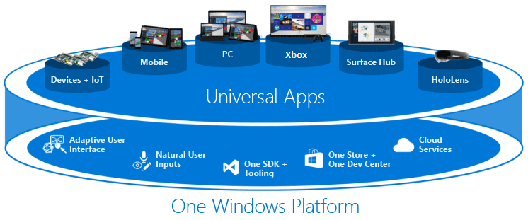
Universal Windows Platform (UWP)
Notes:
Notes:
UWP is a development platform which allows an app that is coded in C# (or other .NET languages) to compile and run on a broad range of Microsoft devices.
These “Universal Apps” will run on Windows 10 mobile devices, such as Windows 10 Phone and Surface, as well as PCs.
They will also run on HoloLens, Xbox, and IoT(Internet of Things) devices.
References:
https://msdn.microsoft.com/windows/uwp/get-started/universal-application-platform-guide

Slide 7
UWP Apps Run On All Windows 10 Devices
Code in C# with Xamarin.Forms in a UWP project
Run on Windows 10 phones and tablets
Run on Windows 10 PCs
Run on Xbox
Run on HoloLens
Notes:
Notes:
An increasing number of cross-platform projects require iOS, Android, and Windows Phone and Desktop platforms.
Xamarin.Forms with UWP gives us the Windows 10 phones and desktops
Windows 8 and 8.1 phones still work with Xamarin.Forms but require a Windows 8 Phone project type (not a UWP project)
IoT device family is very specialized. No UI. Apps targeting IoT cannot run on other devices.

Slide 8
Xamarin.Forms Binds to the Windows 10 SDK
Xamarin
Xamarin.Forms
Xamarin.iOS
Xamarin.Android
iOS UIKit
Android SDK
Windows
SDK
Notes:
Notes:
Xamarin brings C# to iOS and Android development
Windows 10 apps already use C#
Windows 10 contains UWP
References:
Image from Xamarin Mobile Application Development by Dan Hermes, published by Apress http://www.mobilecsharpcafe.com/xamarin-book/

Slide 9
Most Common Platforms for Xamarin.Forms Projects
iOS
Android
Windows 10 Phones, Tablets, and PCs (UWP)
Notes:
Notes:
An increasing number of cross-platform projects require iOS, Android, and Windows Phone and Desktop platforms.
Xamarin.Forms with UWP gives us the Windows 10 phones and desktops
Windows 8 and 8.1 phones still work with Xamarin.Forms but require a Windows 8 Phone project type (not a UWP project)

Slide 10
Why Use Xamarin with UWP?
Xamarin.Forms
Cross-platform application with C# code sharing
Similar toolset
Notes:
Notes:
UWP and Xamarin use a lot of the same tools: C#, Visual Studio, XAML, etc.
It is easier to reuse code written for UWP with Xamarin.Forms than it is to reuse code written using Xamarin.iOS or Xamarin.Android

Slide 11
Create a UWP Project

Slide 12
Minimum System Requirements
Windows 10
Visual Studio 2015
Universal Windows Developer Tools
Xamarin.Forms 2.1
Notes:
Notes:
See Lab 3a for more detail on creating a UWP project

Slide 13
How to Create a UWP project
All requirements are met (listed on the previous slide):
create a Xamarin.Forms solution
a UWP project will be included in your new Xamarin.Forms solution
Existing Xamarin.Forms solution with no UWP project
Add it manually
The following slides detail this process
Notes:
Notes:
Create a Xamarin.Forms solution with all of the minimum systems requirements in place and a UWP project will be included in the solution.
Working with a Xamarin.Forms solution that doesn’t yet have a UWP project in it requires some additional work. We’ll now cover #2 in the upcoming slides.

Slide 14
Add a UWP project to an existing Xamarin.Forms project
Add a Blank App (Universal Windows)
Manage NuGet Packages > and add the Xamarin.Forms 2.0 package
In the Build > Configuration Manager window, tick the Build and Deploy boxes for the Universal project
Add > Reference and create a project reference to the Xamarin.Forms application project (PCL or Shared Project)
Notes:
Notes:
Walk through this process in a live demo, as it will be used in the student lab later on.
Right click a project to do most of these.
Choose mobile device family.

Slide 15
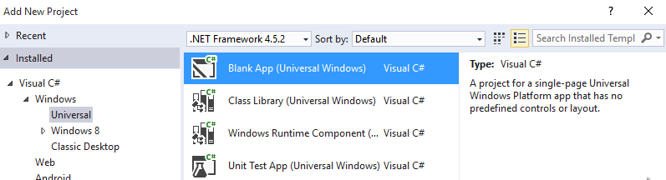
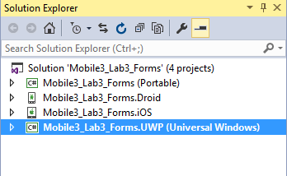
Add a Blank App (Universal Windows)
Notes:
Notes:
Add New UWP Project
See result in the Solution Explorer

Slide 16
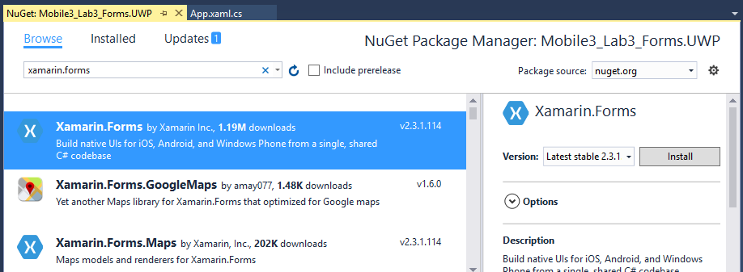
Add the Xamarin.Forms 2.0 NuGet package
Notes:
Notes:
Right click UWP project
Select Manage NuGet Packages
Search for Xamarin.Forms with Package source set to nuget.org
Install Xamarin 2+ in the UWP project

Slide 17
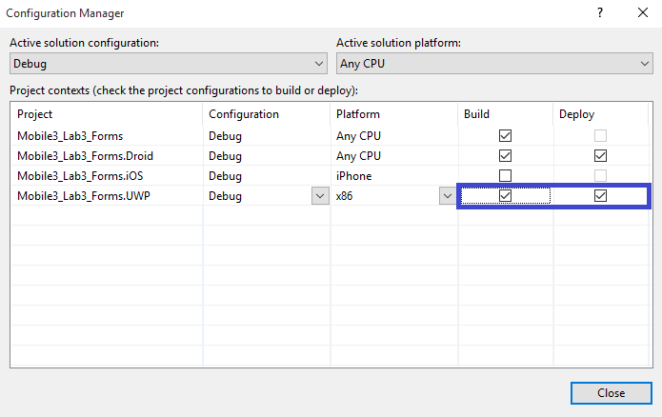
Build and Deploy the Universal project
Notes:
Notes:
Right click solution
Select Configuration Manager
Tick the Build and Deploy boxes for the Universal project

Slide 18
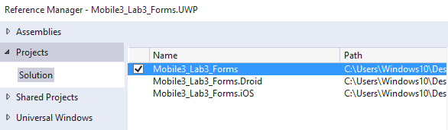
Create a project reference to the Xamarin.Forms app project
Notes:
Temporary image

Slide 19
Initialize Xamarin.Forms in a UWP Project
The previous slides explained the UWP Project set up in Xamarin
The following 3 slides walk through the steps necessary to initialization of Xamarin.Forms in a UWP project
Notes:
Notes:
Right click a project to do most of these.
Remove Page inheritance since forms:WindowsPage causes the main page to inherit form WindowsPage

Slide 20
App.xaml.cs OnLaunched method
rootFrame.NavigationFailed += OnNavigationFailed;
Xamarin.Forms.Forms.Init (e);
Notes:
Notes:
In App.xaml.cs OnLaunched method, add this Init statement.

Slide 21
MainPage.xaml
<forms:WindowsPage xmlns:forms="using:Xamarin.Forms.Platform.UWP"
...>
</forms:WindowsPage>
Notes:
Notes:
In MainPage.xaml, add a new xmlns entry for Xamarin.Forms.Platform.UWP
xmlns:forms="using:Xamarin.Forms.Platform.UWP"
Change the root element <Page to <forms:WindowsPage:
Remove the :Page inheritance specifier for the class name
public sealed partial class MainPage // : Page

Slide 22
MainPage.cs
public sealed partial class MainPage
{
public MainPage()
{
InitializeComponent();
LoadApplication (new YOUR_NAMESPACE.App());
}
}
Notes:
Notes:
Add LoadApplication call in the MainPage constructor
Set the UWP project as the startup project
Add any app code you want to add then…
Compile and run.
Ignore the error: Cannot create an instance of "WindowsPage” if it appears. The XAML editor is still under construction for UWP/Xamarin.Forms.

Slide 23
Device Families
Universal
device family
Desktop
device family
Mobile
device family
Xbox
device family
IoT
device family
IoT headless
device family
HoloLens
device family
Notes:
Notes:
The universal device family is not, directly, the foundation of any OS. Instead, the set of APIs in the universal device family is inherited by child device families. The universal device family APIs are thus guaranteed to be present in every OS and on every device
A device family is a set of APIs collected together and given a name and a version number. A device family is the foundation of an OS. PCs run the desktop OS, which is based on the desktop device family. Phones and tablets, etc., run the mobile OS, which is based on the mobile device family. And so on.
Each child device family adds its own APIs to the ones it inherits. The resulting union of APIs in a child device family is guaranteed to be present in the OS based on that device family, and on every device running that OS.

Slide 24
UWP APIs
Universal Device Family API
Device Family API (ex. Mobile Extension SDK API)

Slide 25
Target the Universal Device Family
<Dependencies>
<TargetDeviceFamily Name="Windows.Universal" MinVersion="10.0.0.0" MaxVersionTested="10.0.0.0" />
</Dependencies>
Target the Mobile Device Family
<Dependencies>
<TargetDeviceFamily Name="Windows.Mobile" MinVersion="10.0.0.0" MaxVersionTested="10.0.0.0" />
</Dependencies>
Notes:
Notes:
In the Package.appxmanifest file, use the Dependencies tag called TargetDeviceFamily and change the Name property to target the API, and the MinVersion and MaxTestedVersion to target the release of the UWP API.
Known Issues with Xamarin.Forms UWP:
The look of some views/pages is not yet finalized
There are a couple of known fatal errors concerning navigation
Text alignment may not be perfect in some titles
These issues are being addressed in each new release.
References:
https://msdn.microsoft.com/en-us/library/windows/apps/dn986903.aspx

Slide 26
Universal Windows Platform (UWP)
Notes:
Notes:
UWP is a development platform which allows an app that is coded in C# (or other .NET languages) to compile and run on a broad range of Microsoft devices.
These “Universal Apps” will run on Windows 10 mobile devices, such as Windows 10 Phone and Surface, as well as PCs.
They will also run on HoloLens, Xbox, and IoT(Internet of Things) devices.
References:
https://msdn.microsoft.com/windows/uwp/get-started/universal-application-platform-guide

Slide 27
UWP Apps Run On All Windows 10 Devices
Code in C# with Xamarin.Forms in a UWP project
Run on Windows 10 phones and tablets
Run on Windows 10 PCs
Run on Xbox
Run on HoloLens
Notes:
Notes:
Summarize the the Lesson:
Basic UWP concepts:
What is the Universal Windows Platform(UWP)?
Creating a UWP project using Xamarin
UWP device families
How UWP apps work in a Xamarin.Forms solution
Minimum Requirements
Creating a UWP Project & Adding Xamarin.Forms
Universal Device Family API
An increasing number of cross-platform projects require iOS, Android, and Windows Phone and Desktop platforms.
Xamarin.Forms with UWP gives us the Windows 10 phones and desktops
Windows 8 and 8.1 phones still work with Xamarin.Forms but require a Windows 8 Phone project type (not a UWP project)
IoT device family is very specialized. No UI. Apps targeting IoT cannot run on other devices.

Slide 28
Summary
In this lesson you have learned:
Basic UWP concepts
How UWP apps work in a Xamarin solution
Notes:
References:
Further reading: https://developer.xamarin.com/guides/xamarin-forms/platform-features/windows/installation/universal/

